Slide 1
Axel Springer SE
Benjamin J. Theisen

Slide 2


Slide 3
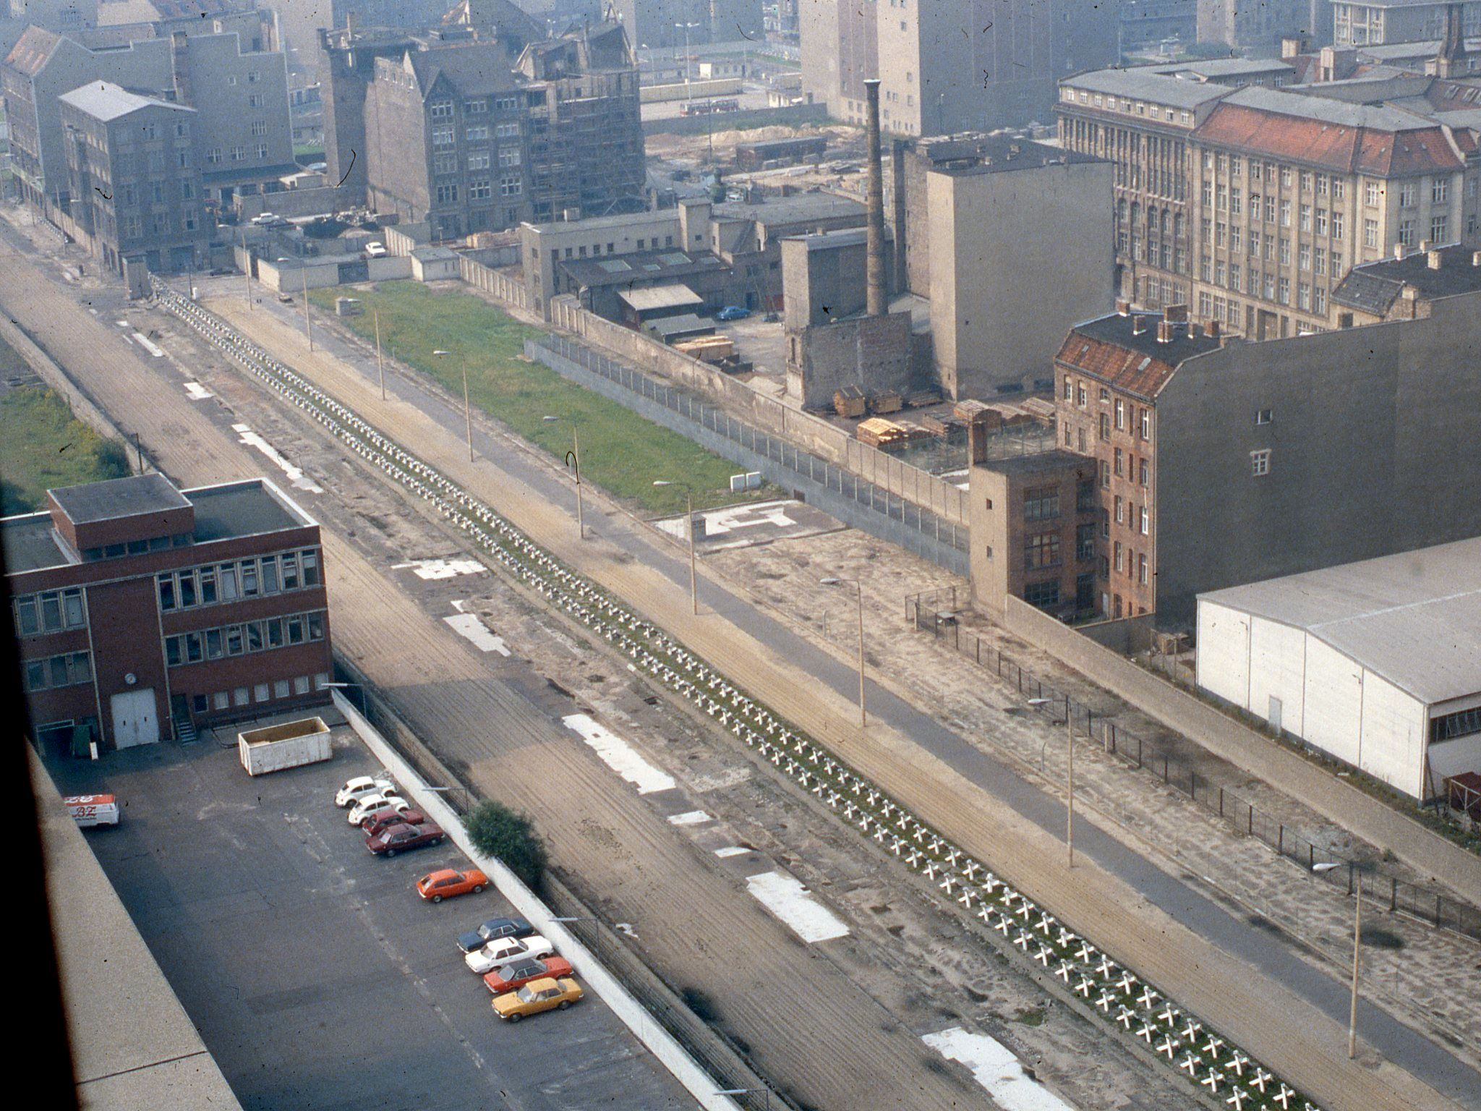
History

Slide 4
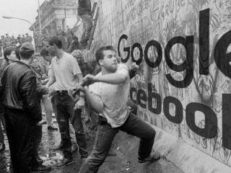

Slide 5
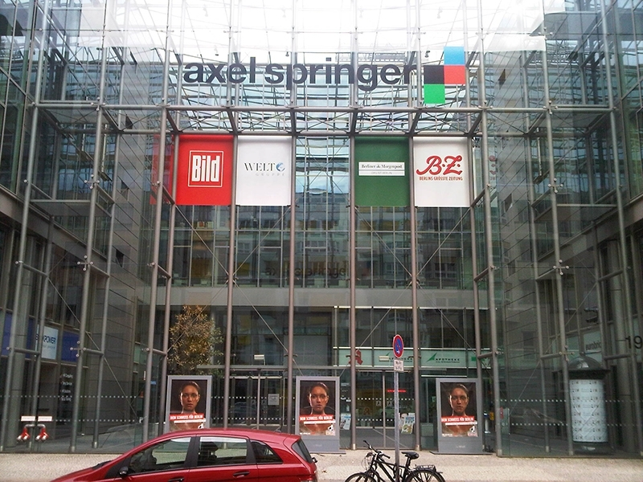

Slide 6
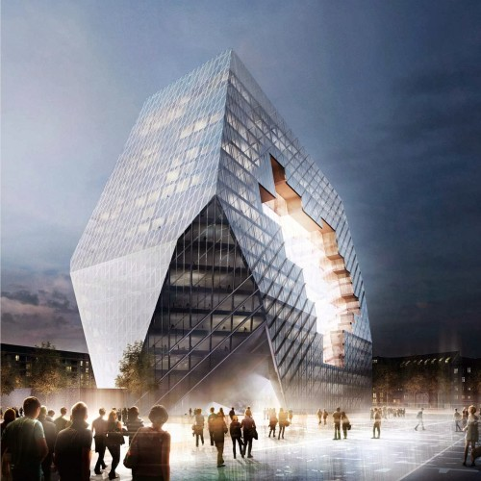
New Media Center Symbolizes the Berlin Wall

Slide 7

Bild

Slide 8
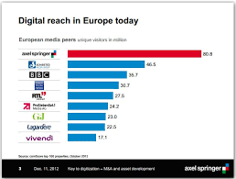


Slide 9
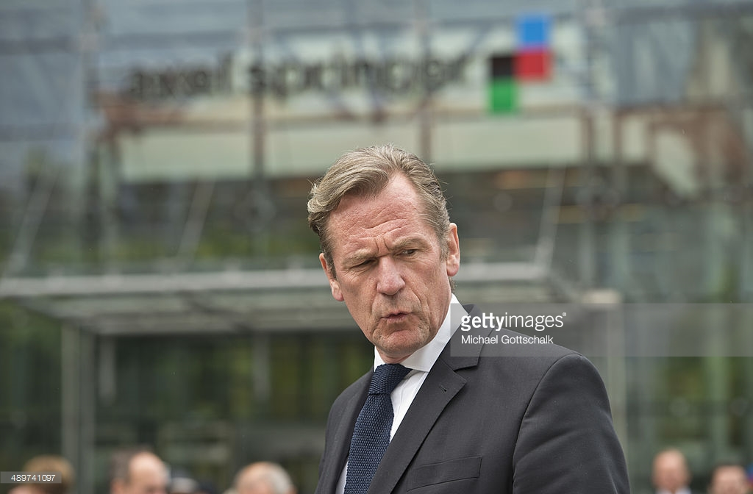
Mathias Dopfner

Slide 10
Strategy Changed from Case Study
“Our goal is to become the world’s leading digital publisher.”
Michael Dopfner
(75 percent revenue now from digital)
(Depends on English speaking markets)
Rapid growth difficult
Need large staff to produce content
Not many possible acquisitions

Slide 11
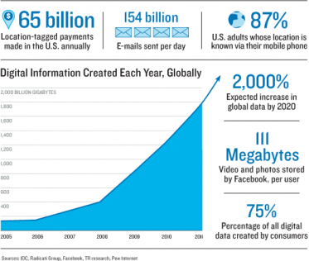

Slide 12
Strategy: Digital Ads, Subscribers
Via Analytics
Cookies vs. Free Logins
Niche of technology industry, controlled by Google and Facebook
Ax. Sprg.’s driver is journalism
Google & Facebook are more general

Slide 13
Ad Model in Tech
Users > data > ML > predict beh. = revenue
Everyone makes more money (except users)
“Journalism” is one of millions of variables here

Slide 14
How targeted are ads?
Rochester study:
307 people
396 cars
32,000 days of GPS data in Microsoft db
Result: Predicted approximate location up to 80 weeks in advance, > 80% accuracy.

Slide 15
Rochester: Commercial Use
Phone displays popup:
“Need a haircut? You’ll be within 100m of a salon in four days with a $5 special at that time.”
[Yes] [No, thanks]
Privacy?
MIT Tcchnology Review: (2013). https://www.technologyreview.com/s/514351/has-big-data-made-anonymity-impossible/

Slide 16
Facebook Tech Facts
Every minute
500K comments
293K status updates
136K photos

Slide 17
Google Tech Facts
40,000 searches per second
That’s 36 million searches for EACH 15-minute presentation you watched today.

Slide 18
White Hat
Open Letter to Google
Google and Facebook as Orwellian
Creating their own currency (behavior)
Silencing dissenters like German Stasi
“Proprietary algorithm” as smokescreen
Threatening self-determination/ autonomous man

Slide 19
Axel Springer Fights on Moral Level
Axel Springer can’t be white hat journalists with black hat websites
Because Google Ranks Punish & Chrome blocks it
You can harm users, lose data, & brick devices with JS

Slide 20
Cookies
“Google is considered by experts to be the absolute leader in the development of technologies which document the movements and habits of users without setting cookies.”
-Mathias Dopfner, CEO
“The core business of the plaintiff is to deliver ads to its visitors. Journalistic content is just a vehicle to get readers to view the ads.”
– Axel Springer’s lawyer http://better.fyi/spotlight

Slide 21
Final Recommendations: 6 months
STOP
Moral attacks, Blocking protected Bild.de viewers
DO
Distribute Bild.de on Facebook bot (2016 dev)
Open alliance talks with Google CEO
$9B/yr from Google News to publishers

Slide 22
Final Recommendations: 1 year
STOP
Banding EU together to build cookies-based malware database. Build a platform instead.
DO
AMAZON: Leverage Bezos investment in BusinessInsider.com acquisition
3% of $500M was from Bezos personal wealth
Grow the Accelerator Plug and Play with a location in new tech hub
Austin, NYC, LA?
Quora.com (tech forum) to own/host conversations...

Slide 23
Quora
100M uniques/month
Talks of pre-IPO,
$85M Elon Musk
Content: unique b/c content without staff
$500 contests
Currently no ads (losing money, big readership, quality content = Ax. Spr. dream)

Slide 24
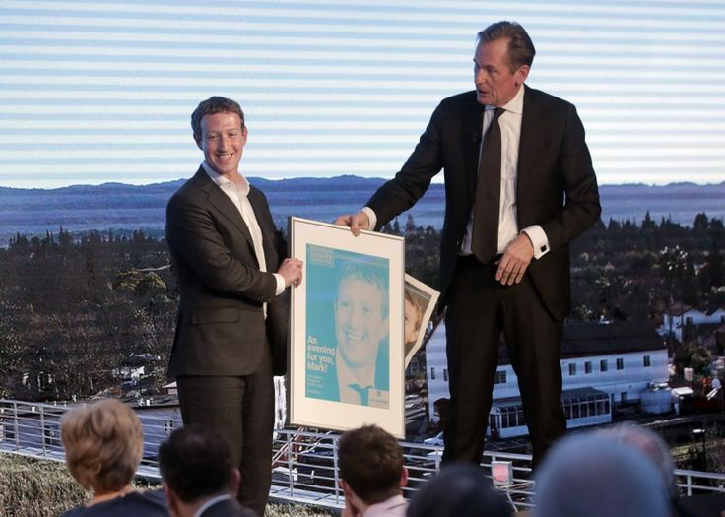
Zuckerberg
2016: Axel Springer SE started testing a Bild.de bot to distribute via Facebook messenger. Recommendation: Expand Facebook delivery.

Slide 25
Financial Recommendation – 2 Years
Look into German equivalent of how Facebook paid $19 B for WhatsApp
FB counted it as a gain (“Goodwill Asset”), same year
S.V. spends much more. How can Axel. Sprg.?
How S.V. firms lose $700M/year and investors cheer?
Dopfner, Top 25 car blog? No, look at WhatsApp.
Ax. Spr. Profit grew 70 % 2016 to 2015 (from digital classifieds)

Slide 26
Final I/O Recommendation - (ongoing)
DO
Continue preserving cultures
Example of Bild.de || Bild
Explore growth of the innovative journalism Dopfner talks about. What programs develop this?
Nurture the youth with tradition and wisdom. Berlin is up and coming tech hub. Leverage with tech startups outside S.V.

Slide 27
Recommendation: 10 Years
If not upstream…
Feeds big tech ML
Acquire Quora.com
Expand Accelerator
Leverage Bezos
Zuck says it will be 10 years before VR. Dopfner is off to a great start…

Slide 28
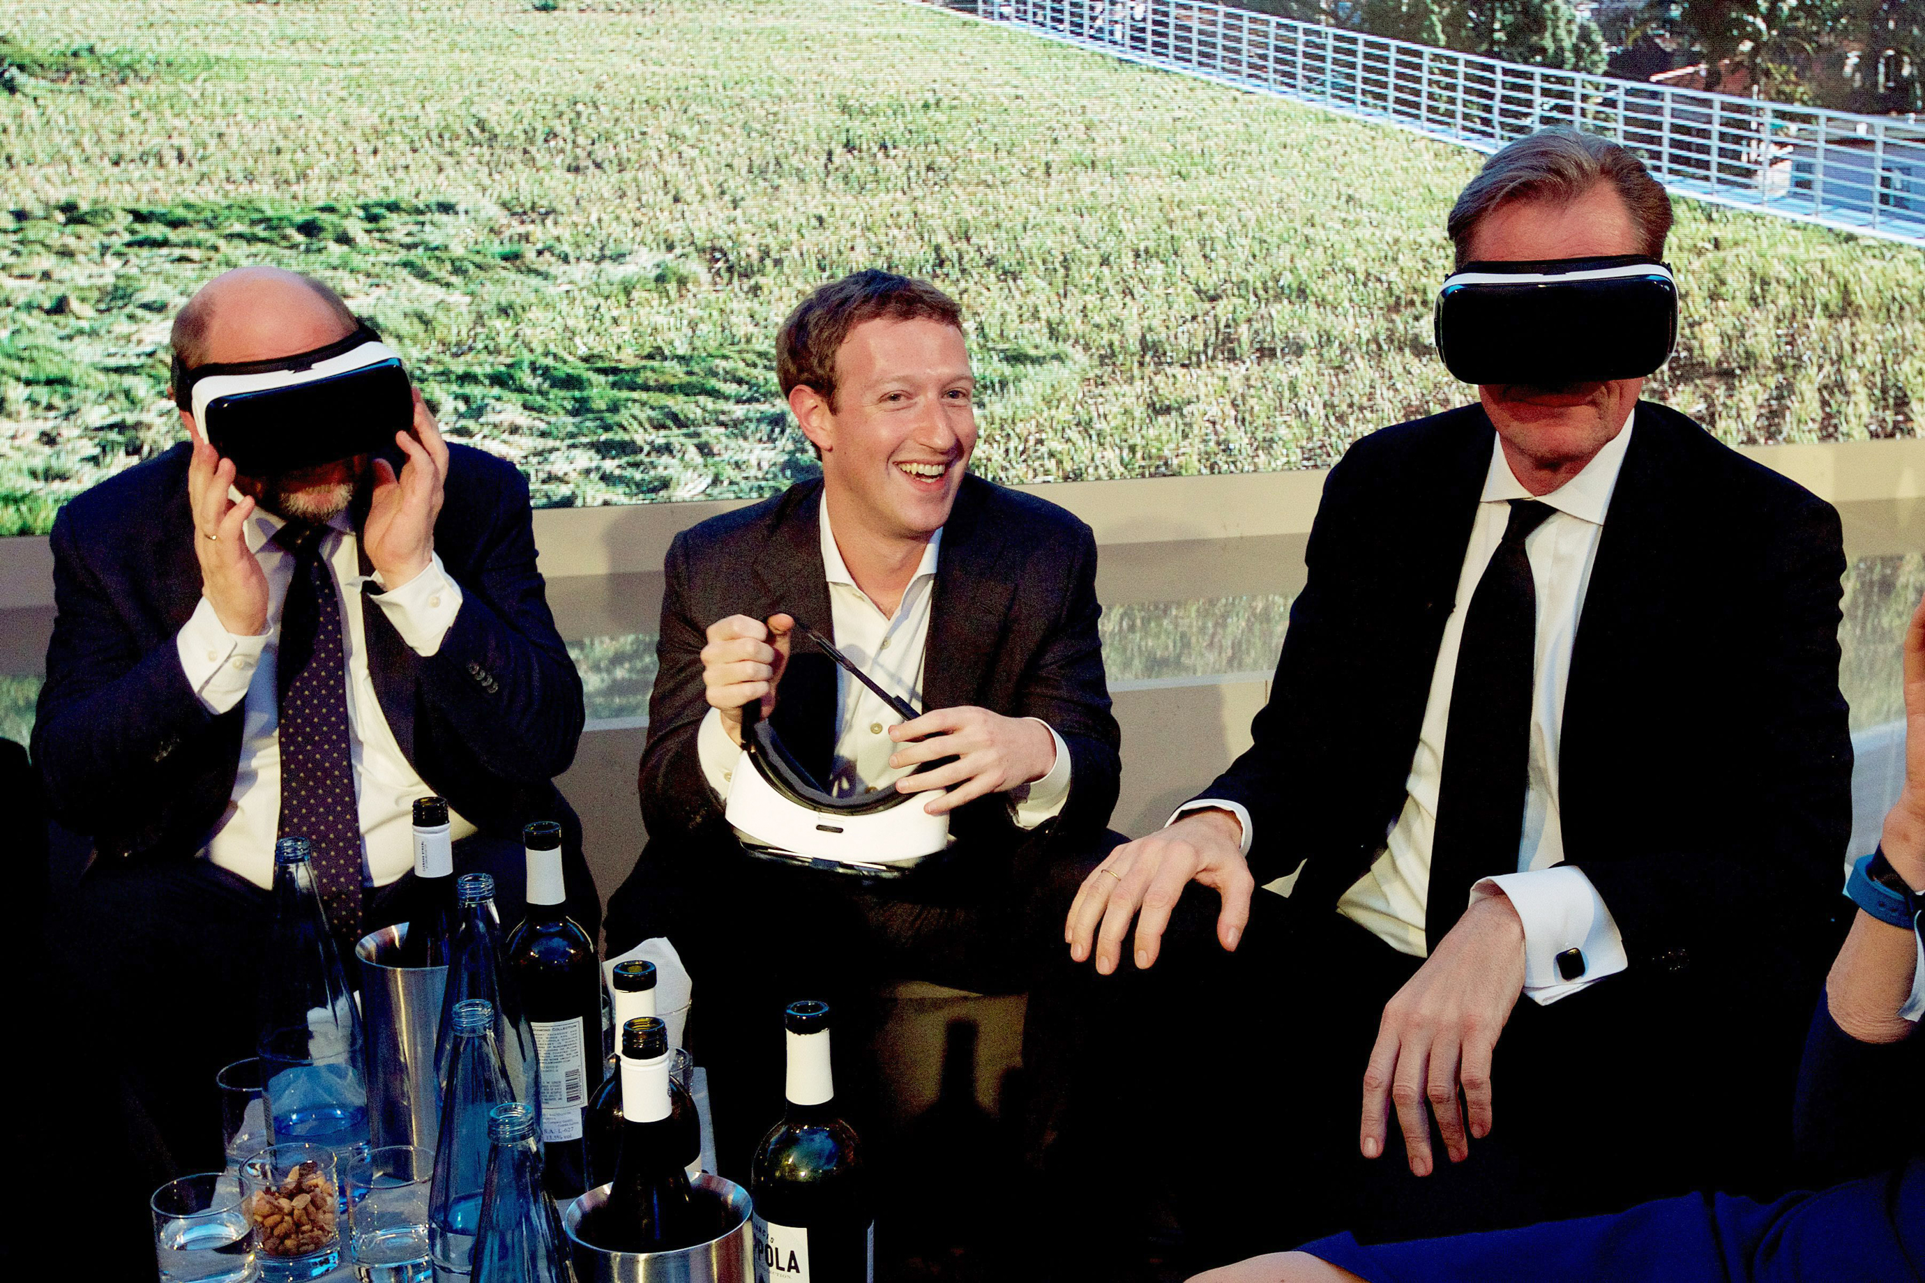

Slide 30
Theory
I/O Model: use to find attractive industry
Resource-based Model of Above Average Returns
In theory: Resources must be valuable, rare, costly to imitate, and non-substitutable
Digital subscription model in publishing industry
Valuable to Amazon Kindle subscriptions, Google News, FB

Slide 31
Acquisition Strategy Theory
Acquisitions are exciting, consuming managers
Top Level Managers
Dissent needed to curb over-involvement in acquisitions
Considers all sides
Managers overly focused on acquisitions rely on financial controls (ROI), for short term outcomes

